Slide 1

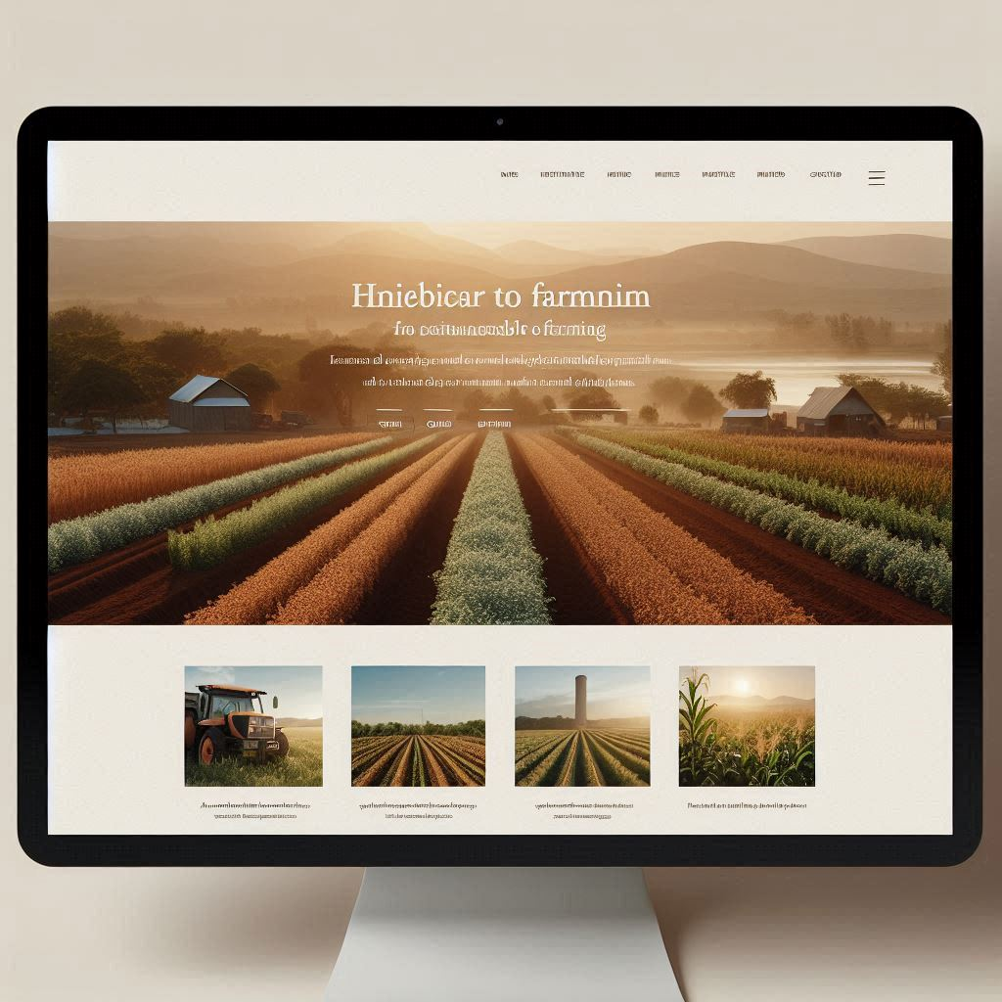
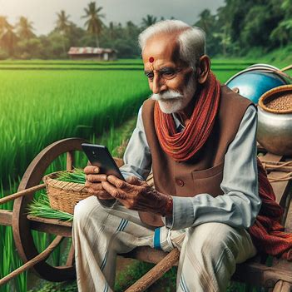

FARMCARE: Farmer’s BackBone
Crop Monitoring Using Computer Vision
Team: Sophisticated Ai
Ashok Suthar

Slide 2
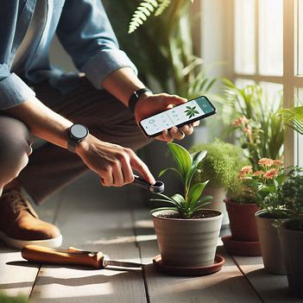
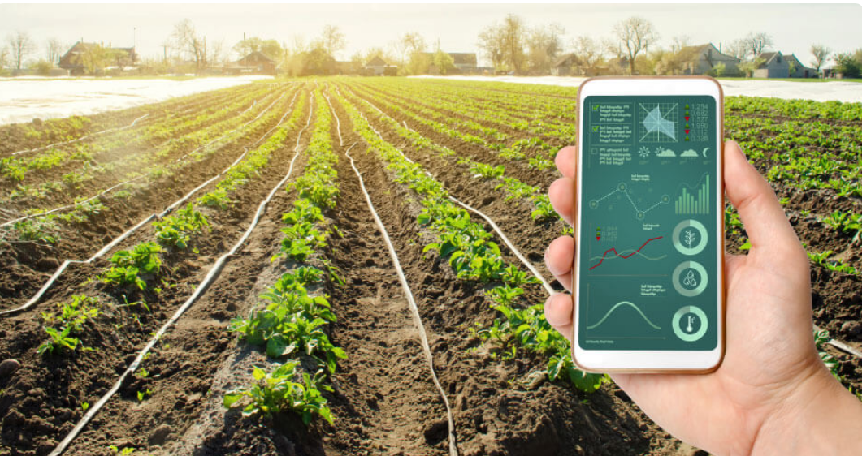
Pr Problem Statement
A farmer is the Backbone of a country(India) and farmers are going through a crisis due to varias reasons.
Computer vision is a great way to know more about crops and help farmers technically analysis the field at a low cost
A simpler UI and interactive models might save money and the lives of many farmers in India. So, This project is all-rounder support a farmer can ask for.
Lets provide Technical Eyes to Farmers!!

Slide 3
StakeHolders Statistics
Farmers
Botanists
Department of Agriculture
Researchers/scientist
Computer vision has been used in agriculture to increase crop yields by 4–6%
The global market for computer vision in agriculture is projected to reach several billion dollars by 2025, with a compound annual growth rate (CAGR) exceeding 20%.
Accuracy rates for yield estimation using CV algorithms can exceed 90% in some cases.

Slide 4
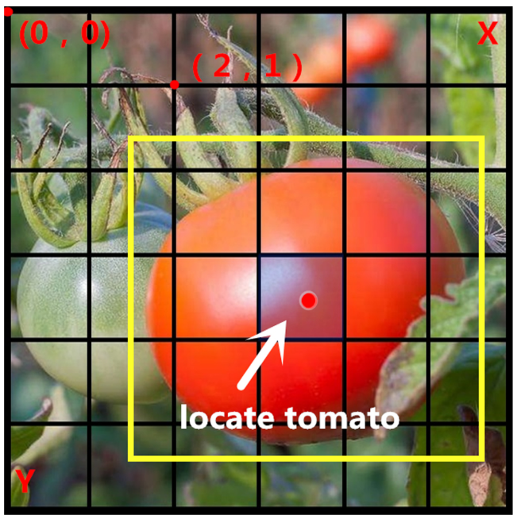
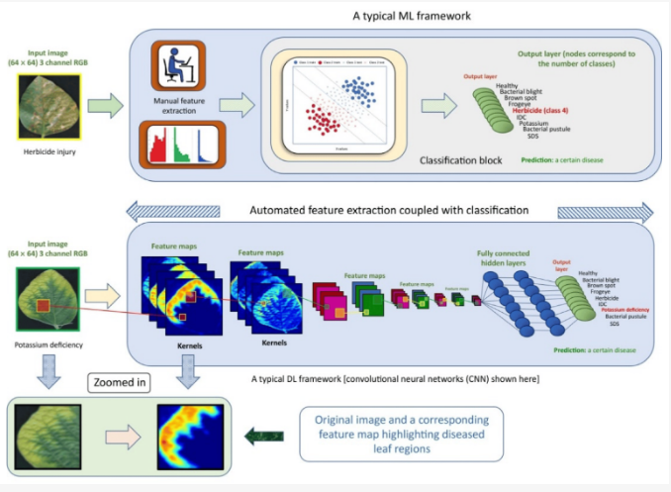
Existing System
Weed Detection and Management Systems
Crop Disease Identification and Diagnosis
Soil texting using computer vision
LIMITATIONS:
Using Technical and heavy words .
Old Datasets
New Research in GenAI

Slide 5
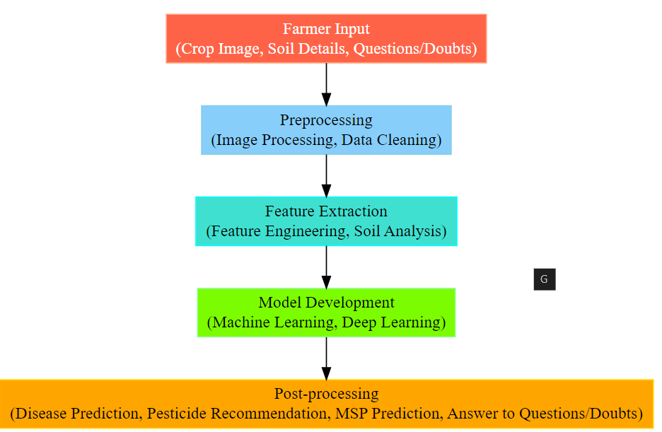
Proposed System
Our Model is a all-rounder farmer’s helper using computer vision
FEATURES:
Detecting plant disease
Recommend pesticides
Soil Analysis and solutions
MSP –connecting to buyers
Multi-Lingual ChatBot

Slide 6
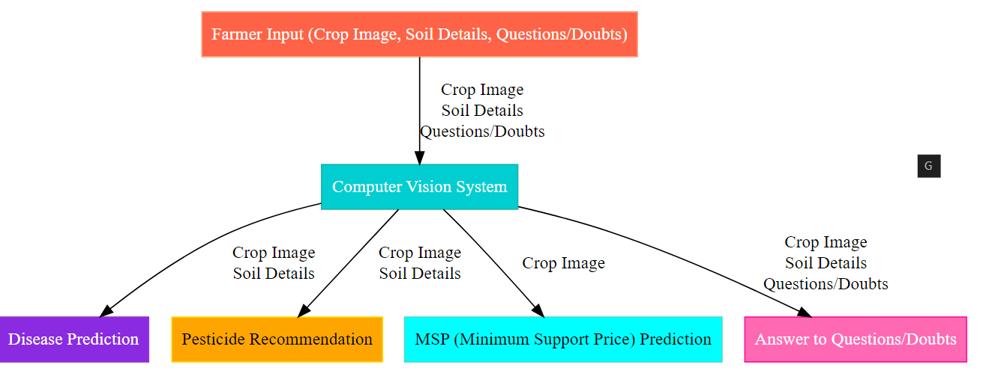
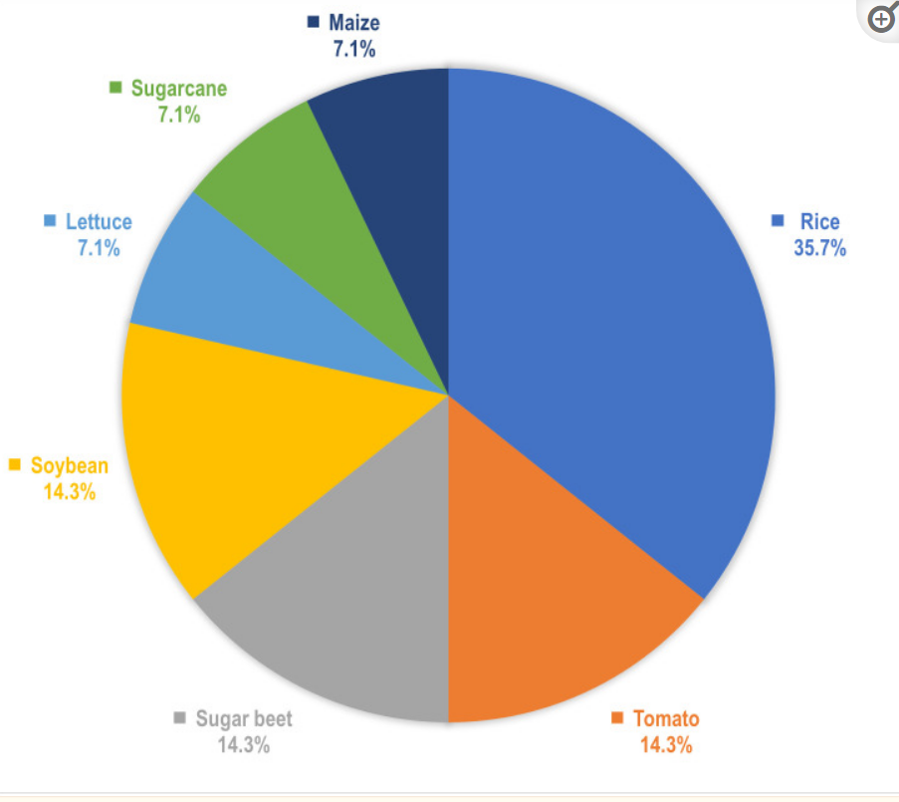
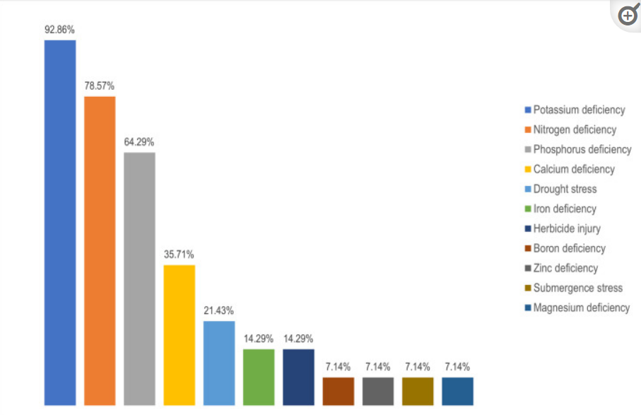
Architecture /Block Diagram

Slide 7
References
Inspiration: https://github.com/Gladiator07/Harvestify
MSP Dataset: https://data.gov.in/resource/commodity-wise-details-minimum-support-price-msp-mandated-crops-during-2000-01-2017-18-and?as_fid=41dae52b62435359a38574822b144af9f30ef1d0
Plant disease dataset: https://www.kaggle.com/datasets/vipoooool/new-plant-diseases-dataset
Plant recommendation : https://www.kaggle.com/datasets/atharvaingle/crop-recommendation-dataset
Chatbot : https://www.researchgate.net/publication/366759579_A_Machine_Learning Based_Mobile_Chatbot_for_Crop_Farmers
Inspiration: https://github.com/Gladiator07/Harvestify

Slide 8


